Slide 1
Speech Emotion Recognition
Spectrogram

Slide 2
Link
https://github.com/Data-Science-kosta/Speech-Emotion-Classification-with-PyTorch/blob/master/notebooks/stacked_cnn_attention_lstm.ipynb
Dataset
Ravadess speech
Accuracy
Link accuracy 95% (but he did not mention if it is testing or training)
→ 61% testing accuracy (CNN and LSTM)

Slide 3
Link
https://github.com/Data-Science-kosta/Speech-Emotion-Classification-with-PyTorch/blob/master/notebooks/parallel_cnn_attention_lstm.ipynb
Dataset
RAVADESS speech
Accuracy
Link accuracy 94% (but he did not mention if it is testing or training)
64.5% testing accuracy (CNN AND LSTM)
Note: we trained model using 16 actors instead of 24 actors due to model training took more than 6 hours training (Cloud limitation)

Slide 4
Link
https://github.com/rajamohanharesh/Emotion-Recognition/blob/master/Codes/4.6%20Final%20Model%20Ravdess%202D%20CNN%20_Log%20Mel%20Spectogram_6L_64_.ipynb
Dataset
Ravadess speech and song
Accuracy
Link accuracy 76% testing
→ 69% testing accuracy

Slide 5
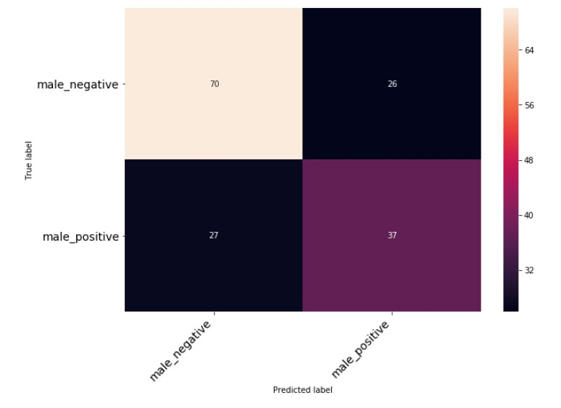
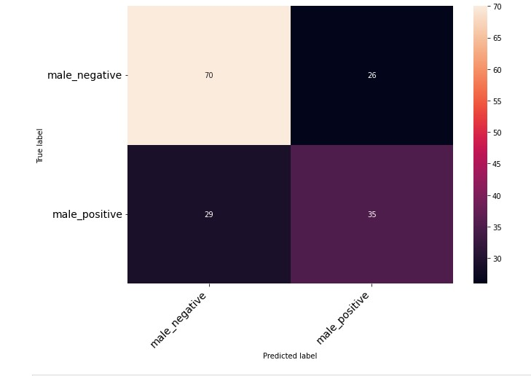
Link
https://github.com/rezachu/emotion_recognition_cnn/blob/master/CNN_emotion_recognition.ipynb
Dataset
Ravadess speech and song
Accuracy
Link accuracy 66%
→ 65% testing accuracy
His Confusion matrix | Our Confusion after training

Slide 6
Link
https://github.com/Data-Science-kosta/Speech-Emotion-Classification-with-PyTorch
This link include 4 models we trained 4 models using ravadess dataset
Dataset used | Github link accuracy | Our Accuracy after training
Ravadess speech | 94.02% (did not mention if it test or train) | 64%
Ravadess speech (Kernel dead when training using both speech and song) | 95% (did not mention if it test or train) | 61%
Ravadess speech | 96% | 55%
Ravadess speech | 95% | 50%

Slide 7
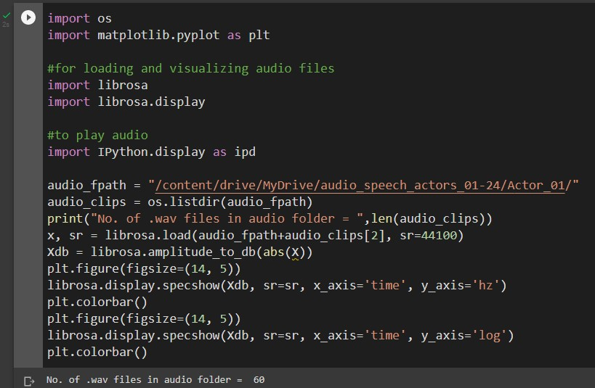
Link
https://github.com/mkosaka1/Speech_Emotion_Recognition/blob/master/3.%20Transfer_Learning%20-%20Initial_Model.ipynb
This link contains more than one model we trained two model from them
VGG16 Fine Tuning With Image Augmentation
VGG19 Fine Tuning + Augmentation
This model code started from reading spectrogram files in his path and also change labels of dataset
from numbers to classes ex 01 to neutral
Steps we did before running the code
we wrote a code to get dataset spectrogram

Slide 8
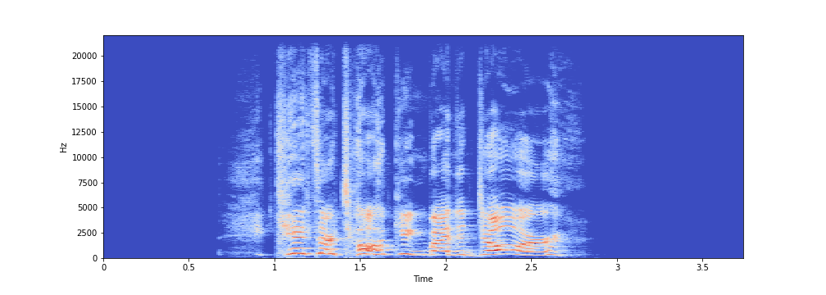
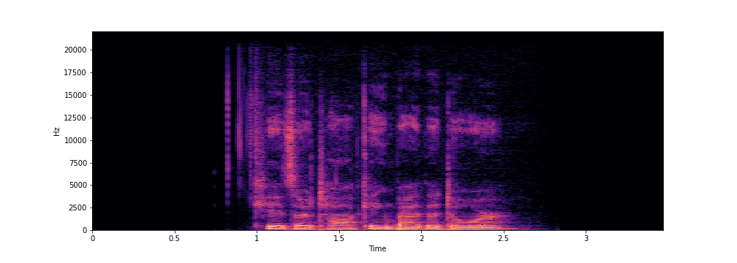
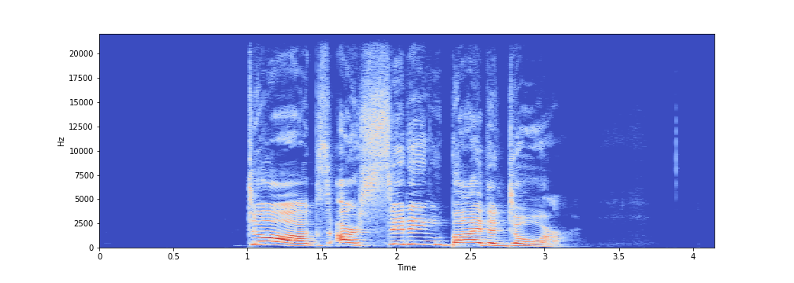
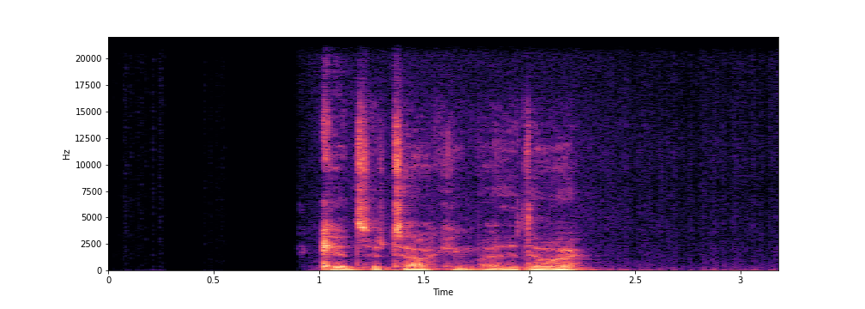
Samples from training dataset

Slide 9
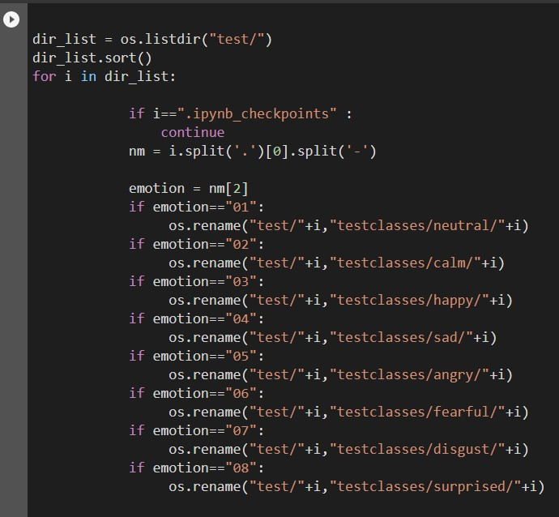
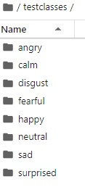
2. We wrote code to convert dataset labeling into Classes
Code Output of code

Slide 10
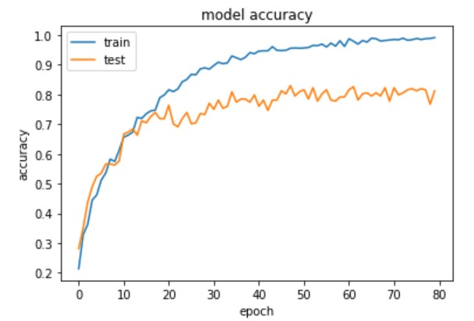
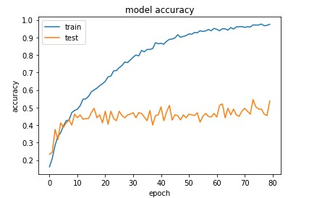
We trained VGG16 Fine Tuning With Image Augmentation model he mentioned accuracy is 80% testing accuracy we trained model using Ravadess speech and we achieved 55% testing accuracy
His model accuracy plot | Our model accuracy plot after training

Slide 11
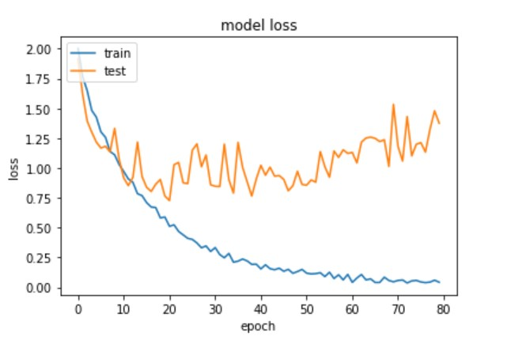
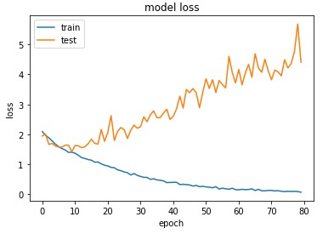
His model loss plot | Our model loss plot after training

Slide 12
We trained VGG19 Fine Tuning + Augmentation model he mentioned accuracy is 88% testing accuracy we trained model using Ravadess speech and we achieved 70% testing accuracy

